Slide 1
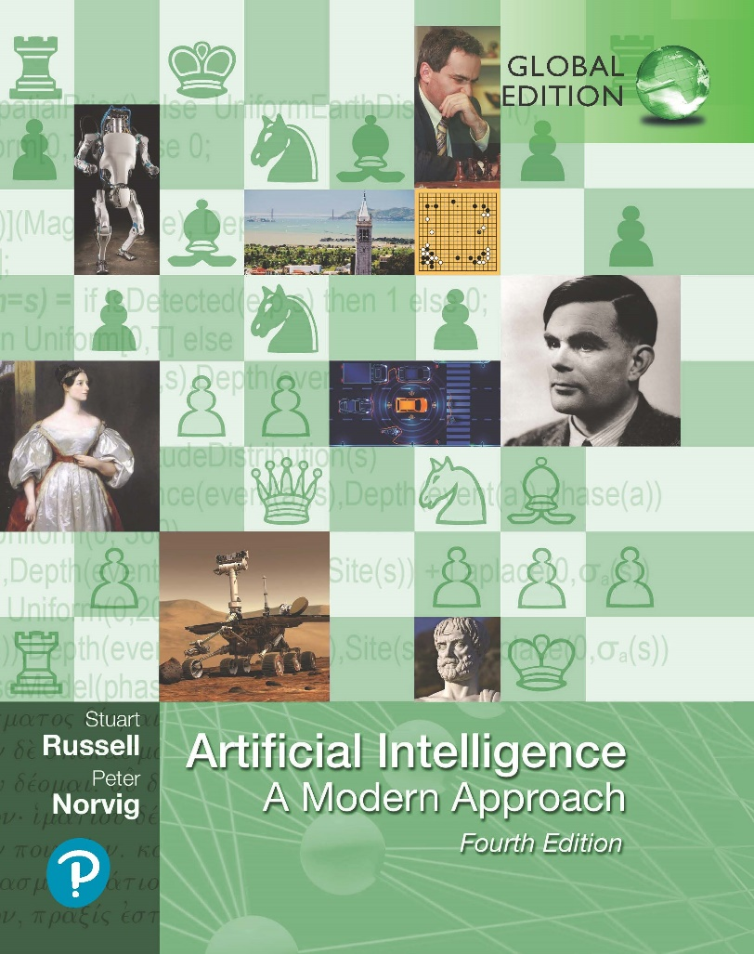
Artificial Intelligence: A Modern Approach
Fourth Edition, Global Edition
Chapter 18
Probabilistic Programming
© 2022 Pearson Education Ltd.

Slide 2
Outline
Relational Probability Models
Open-Universe Probability Models
Keeping Track of a Complex World
Programs as Probability Models
© 2022 Pearson Education Ltd.

Slide 3
Relational Probability Models
Relational Probability Models (RPM) have no closed-world assumptions.
Syntax and semantics
Constant, function, and predicate symbols
type signature for each function: specification of the type of each argument and the function’s value
Eliminates possible worlds
Book-recommendation domain:
The types = Customer and Book
Type signatures for functions & predicates:
Honest : Customer → {true, false}
Kindness : Customer → {1, 2, 3, 4, 5}
Quality : Book → {1, 2, 3, 4, 5}
Recommendation : Customer×Book → {1, 2, 3, 4, 5}

Slide 4
Relational Probability Models
Basic random variables of the RPM are obtained by instantiating each function with each possible combination of objects
Honest(C₁), Quality(B₂), Recommendation(C₁, B₂),
One dependency statement for each function
for any customer c and book b, the score depends on the honesty and kindness of the customer and the quality of the book:
Recommendation(c, b) ∼ RecCPT(Honest(c), Kindness(c), Quality(b))
RecCPT is a separately defined conditional probability table with 2 x 5 x 5 = 50 rows, each with 5 entries.

Slide 5
Relational Probability Models
context-specific independence
Recommendation(c, b) if Honest(c) then
HonestRecCPT(Kindness(c), Quality(b))
else (0.4, 0.1, 0.0, 0.1, 0.4) .
Further elaboration
Recommendation(c, b) if Honest(c) then
if Fan(c, Author(b)) then Exactly(5)
else HonestRecCPT(Kindness(c), Quality(b))
else (0.4, 0.1, 0.0, 0.1, 0.4)

Slide 6
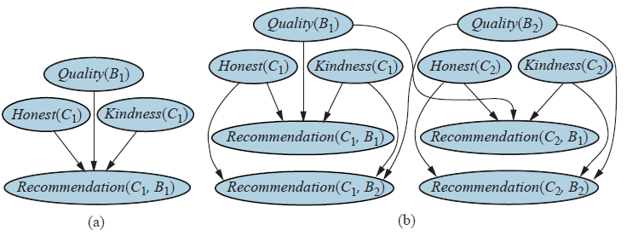
Relational Probability Models
(a) Bayes net for a single customer C₁ recommending a single book B₁. Honest(C₁) is Boolean, while the other variables have integer values from 1 to 5. (b) Bayes net with two customers and two books.

Slide 7
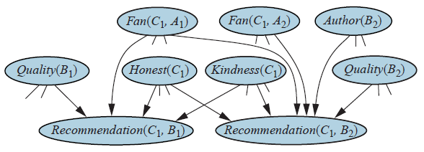
Relational Probability Models
Fragment of the equivalent Bayes net for the book recommendation RPM when
Author(B₂) is unknown.

Slide 8
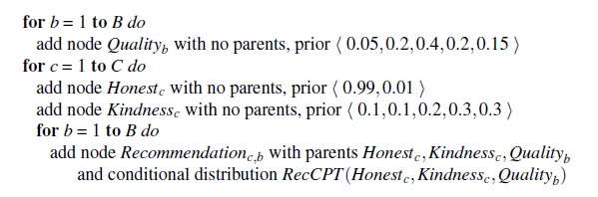
Inference in relational probability models
RPM Inference approach: construct the equivalent Bayesian network, given the known constant symbols belonging to each type (grounding/unrolling)
Example:

Slide 9
Inference in relational probability models
Drawbacks of grounding:
Large Bayes net
Many parents of variables
Countermeasures:
Elimination algorithm, chaining from query and evidence
Repeated stubstrucutre
MCMC inference algorithms: sampling complete possible worlds.
Resolution theorem provers: instantiating the logical variables only as needed

Slide 10
Open-Universe Probability Models
Example: ISBN for books ID, may have several IDs for same book differentiated by hardcover paperback, large print, etc.
Sybils: multiple IDs
Sybil attack: confound a reputation system
Existence uncertainty eg: what are the real books and customers underlying the observed data?
Identity uncertainty eg: which logical terms really refer to the same object

Slide 11
Open-Universe Probability Models
Open universe probability model (OUPM): allows generative steps compared to RPM
add objects to the possible world under construction, where the number and type of objects may depend on the objects that are already in that world and their properties and relations
# Customer ∼ UniformInt(1, 3)
# Book ∼ UniformInt(2, 4) .
# LoginID(Owner = c) ∼ if Honest(c) then Exactly(1)
else UniformInt(2, 5) .
Owner function is an origin function

Slide 12
Open-Universe Probability Models
UniformInt: Uniform distribution used in example, for nonnegative integers, Poisson Distribution is commonly used:
P(X = k) = λ^{k}e^{−λ}/k! .
For large numbers, discrete log-normal distribution and order-of-magnitude distribution where OM(3,1) = 10³ Standard deviation between 10² and 10⁴.
Number variables of an OUPM: number objects there are of each type with each possible origin in each possible world
#LoginID _{(Owner, (Customer,,2)) (ω)} = 4, in world ω, customer 2 owns 4 login IDs.
Basic random variables determine the values of predicates and functions for all tuples of objects
Honest_{(Customer,,2)}(ω) =true means that in world ω, customer 2 is honest.

Slide 13
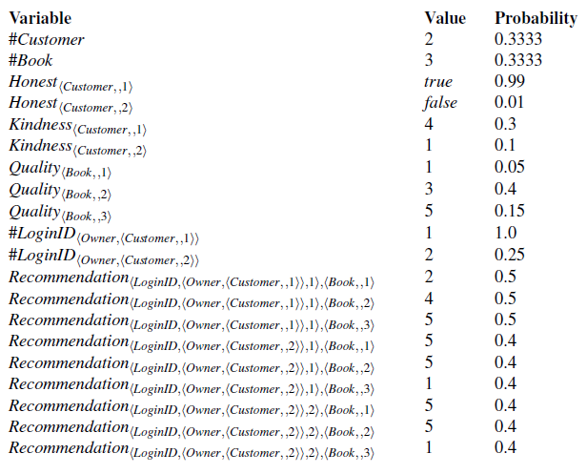
Open-Universe Probability Models
One particular world for the book recommendation OUPM. The number variables and basic random variables are shown in topological order, along with their chosen values and the probabilities for those values.

Slide 14
Inference in open-universe probability models
Citation matching
type Researcher, Paper,
Citation random String Name(Researcher)
random String Title(Paper)
random Paper CitedPaper(Citation)
random String Text(Citation)
random Boolean Professor(Researcher)
origin Researcher Author(Paper)
#Researcher ∼ OM(3, 1)
Name(r) ∼ NamePrior()
Professor(r) ∼ Boolean(0.2)
#Paper(Author = r) ∼ if Professor(r) then OM(1.5, 0.5) else OM(1, 0.5)
Title(p) ∼ PaperTitlePrior()
CitedPaper(c) ∼ UniformChoice({Paper p})
Text(c) ∼ HMMGrammar(Name(Author(CitedPaper(c))), Title(CitedPaper(c)))
An OUPM for citation information extraction. For simplicity the model assumes
one author per paper and omits details of the grammar and error models.

Slide 15
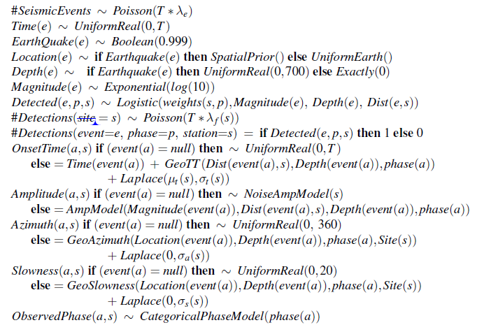
Inference in open-universe probability models
Nuclear treaty monitoring
A simplified version of the NET-VISA model

Slide 16

Keeping Track of a Complex World
Data association problem: problem of associating observation data with the objects that generated them
Multitarget tracking
A₁ and A₂ are guaranteed objects,
true positions be X (A₁,t) and X (A₂,t), where t is a nonnegative integer that indexes the sensor update times.
the first observation arrives at t = 1, and at time 0 the prior distribution for every aircraft’s location is InitX().
assume that each aircraft moves independently according to a known transition model
sensor model: again, we assume a linear–Gaussian model where an aircraft at position x produces a blip b whose observed blip position Z(b) is a linear function of x with added Gaussian noise.

Slide 17
Keeping Track of a Complex World
n known objects generating n observations
Real applications of data association are typically much more complicated.
False alarms (clutter): not caused by real objects
Detection failures: no observation reported for real object
Many research studies simply try to work out the complex mathematical details of the probability calculations
Practical point of view, complexity of inference of the OUPM
Simplest approach is to choose a single “best” assignment at each time step, given the predicted positions of the objects at the current time
Using Nearest-neighbor filter
However fails under more difficult conditions.
Solution: MCMC algorithm, explores the space of assignment histories

Slide 18
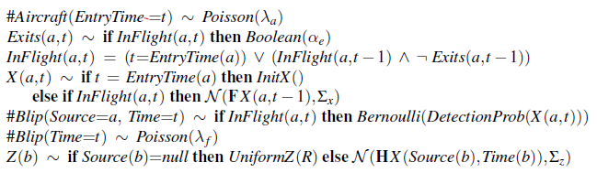
Keeping Track of a Complex World
An OUPM for radar tracking of multiple targets with false alarms, detection failure, and entry and exit of aircraft. The rate at which new aircraft enter the scene is λ_{a}, while the probability per time step that an aircraft exits the scene is α_{e}. False alarm blips (i.e., ones not produced by an aircraft) appear uniformly in space at a rate of λ _{f} per time step. The probability that an aircraft is detected (i.e., produces a blip) depends on its current position.

Slide 19
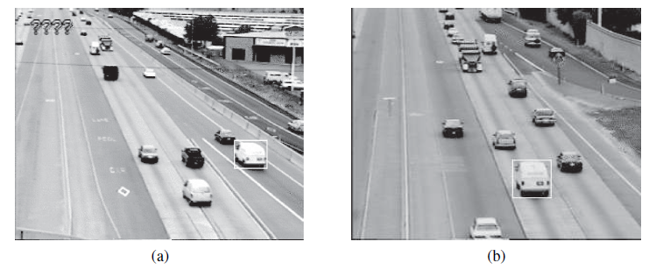
Keeping Track of a Complex World
Example: Traffic monitoring
Images from (a) upstream and (b) downstream surveillance cameras roughly two miles apart on Highway 99 in Sacramento, California. The boxed vehicle has been identified at both cameras.

Slide 20
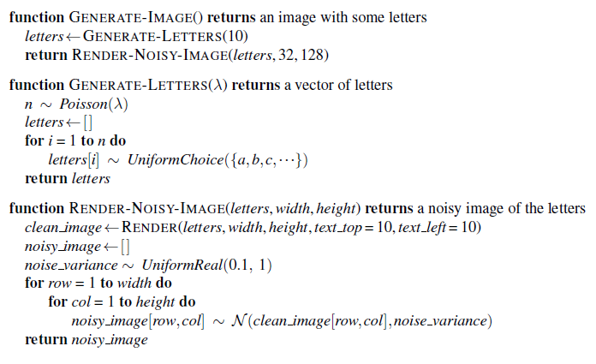
Keeping Track of a Complex World
Example: Traffic monitoring
Generative program for an open-universe probability model for optical character recognition. The generative program produces degraded images containing sequences of letters by generating each sequence, rendering it into a 2D image, and incorporating additive
noise at each pixel.

Slide 21
Programs as Probability Models
Probabilistic programming languages (PPL) built on the insight that probability models can be defined using executable code in any programming language that incorporates a source of randomness.
inherit all of the expressive power
computationally universal
Example: Reading text
Program that reads degraded text
built for reading text that has been smudged or blurred due to water damage, or spotted due to aging of the paper on which it is printed.
can also be built for breaking some kinds of CAPTCHAs.
A generative program that has two components:
a way to generate a sequence of letters
a way to generate a noisy, blurry rendering of these letters using an off-the-shelf graphics library.

Slide 22
Programs as Probability Models
Probabilistic programming languages (PPL) built on the insight that probability models can be defined using executable code
inherit all of the expressive power
computationally universal
Example: Reading text
Program that reads degraded text
built for reading text that has been smudged or blurred due to water damage, or spotted due to aging of the paper on which it is printed.
can also be built for breaking some kinds of CAPTCHAs.
A generative program: executable program in which every random choice defines a random variable in an associated probability model
For reading text, a generative program that has two components:
a way to generate a sequence of letters
a way to generate a noisy, blurry rendering of these letters using an off-the-shelf graphics library.

Slide 23
Programs as Probability Models
X_{i} : random variable corresponding to the ith random choice made by the program
x_{i} : a possible valueof X_{i}
ω = {x_{i}} : execution trace
sequence of possible values for the random choices
Probability distribution over traces: product of the probabilities of each individual random choice: P(ω) = ∏_{i} P(x_{i}|x_{1, … ,} x_{i−1}).
PPL modular in a way that makes it easy to explore improvements to the underlying model.
Can be improved by incorporating a Markov Model

Slide 24
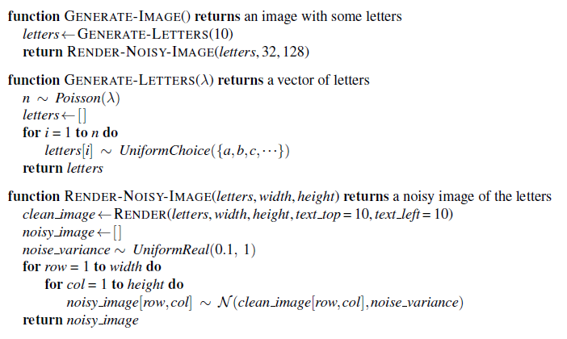
Programs as Probability Models
Generative program for an open-universe probability model for optical character recognition. The generative program produces degraded images containing sequences of letters by generating each sequence, rendering it into a 2D image, and incorporating additive noise at each pixel.

Slide 25
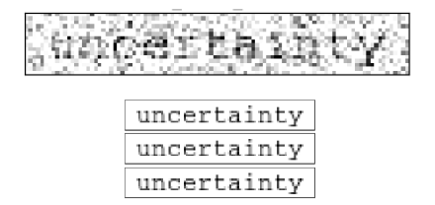
Programs as Probability Models
Noisy input image (top) and inference results (bottom) produced by three runs, each of 25 MCMC iterations, with the model from the previous generative program. Note that the inference process correctly identifies the sequence of letters.

Slide 26
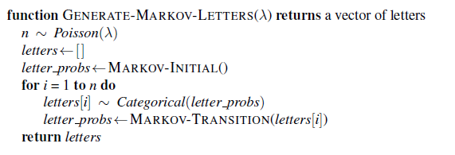
Programs as Probability Models
Generative program for an improved optical character recognition model that generates letters according to a letter bigram model whose pairwise letter frequencies are estimated from a list of English words

Slide 27
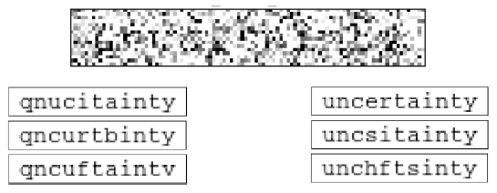
Programs as Probability Models
Top: extremely noisy input image. Bottom left: with three inference results from 25 MCMC iterations with the independent-letter model from previous generative program.
Bottom right: three inference results with the letter bigram model. Both models exhibit ambiguity in the results, but the latter model’s results reflect prior knowledge of plausible letter sequences

Slide 28
Summary
Relational probability models (RPMs) define probability models on worlds derived from the database semantics for first-order languages
RPMs provide very concise models for worlds with large numbers of objects and can handle relational uncertainty.
Open-universe probability models (OUPMs) build on the full semantics of first-order logic, allowing for new kinds of uncertainty such as identity and existence uncertainty.
Generative programs are representations of probability models—including OUPMs— as executable programs in a probabilistic programming language or PPL.
A generative program represents a distribution over execution traces of the program.
PPLs typically provide universal expressive power for probability models.

